Slide 1
Region Processing III
Prof. Eric Miller
elmiller@ece.tufts.edu
Fall 2009
EN 74-ECE Image Processing
Lecture 7-<number>

Slide 2
Finding edges
Another very common task in image processing is finding edges in images
Ideal 1D edge
Want a filter that outputs a large value only where the edge is. Something like
What can we use?
Fall 2009
EN 74-ECE Image Processing
Lecture 7-<number>

Slide 3
2D edges
In 2D we have lots more possibilities for edges
What can we do??
Here: stick with horizontal and vertical edges
Fall 2009
EN 74-ECE Image Processing
Lecture 7-<number>

Slide 4
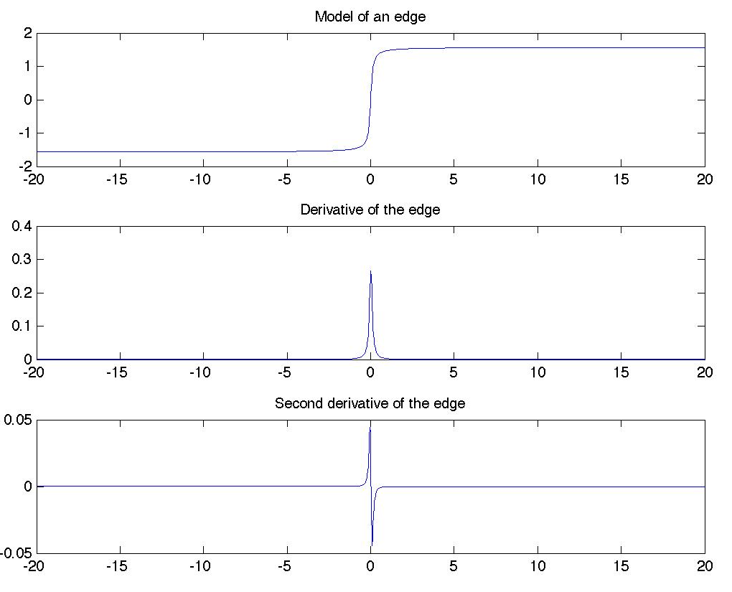



1D Edges
Edge = peak in first derivative
Edge = zero crossing in second derivative
Fall 2009
EN 74-ECE Image Processing
Lecture 7-<number>

Slide 5
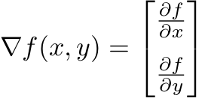

Edge Filtering
Most edge filters in 2D operate on the same ideas
2D first derivative = gradient
2D second derivative = Laplacian
y
Vertical edges
x
Horizontal edges
Fall 2009
EN 74-ECE Image Processing
Lecture 7-<number>

Slide 6



Discrete Derivatives = Filters
With y fixed, the partial derivative with respect to x is just the difference between f at x and f at x plus a little
In a digital image, we can only move over by discrete pixels so the digital version of the above is
Similarly, for horizontal edges we would have
-1
-1
0
1
h_{v}[m,n]
-1
1
-1
0
h_{h}[m,n]
Fall 2009
EN 74-ECE Image Processing
Lecture 7-<number>

Slide 7
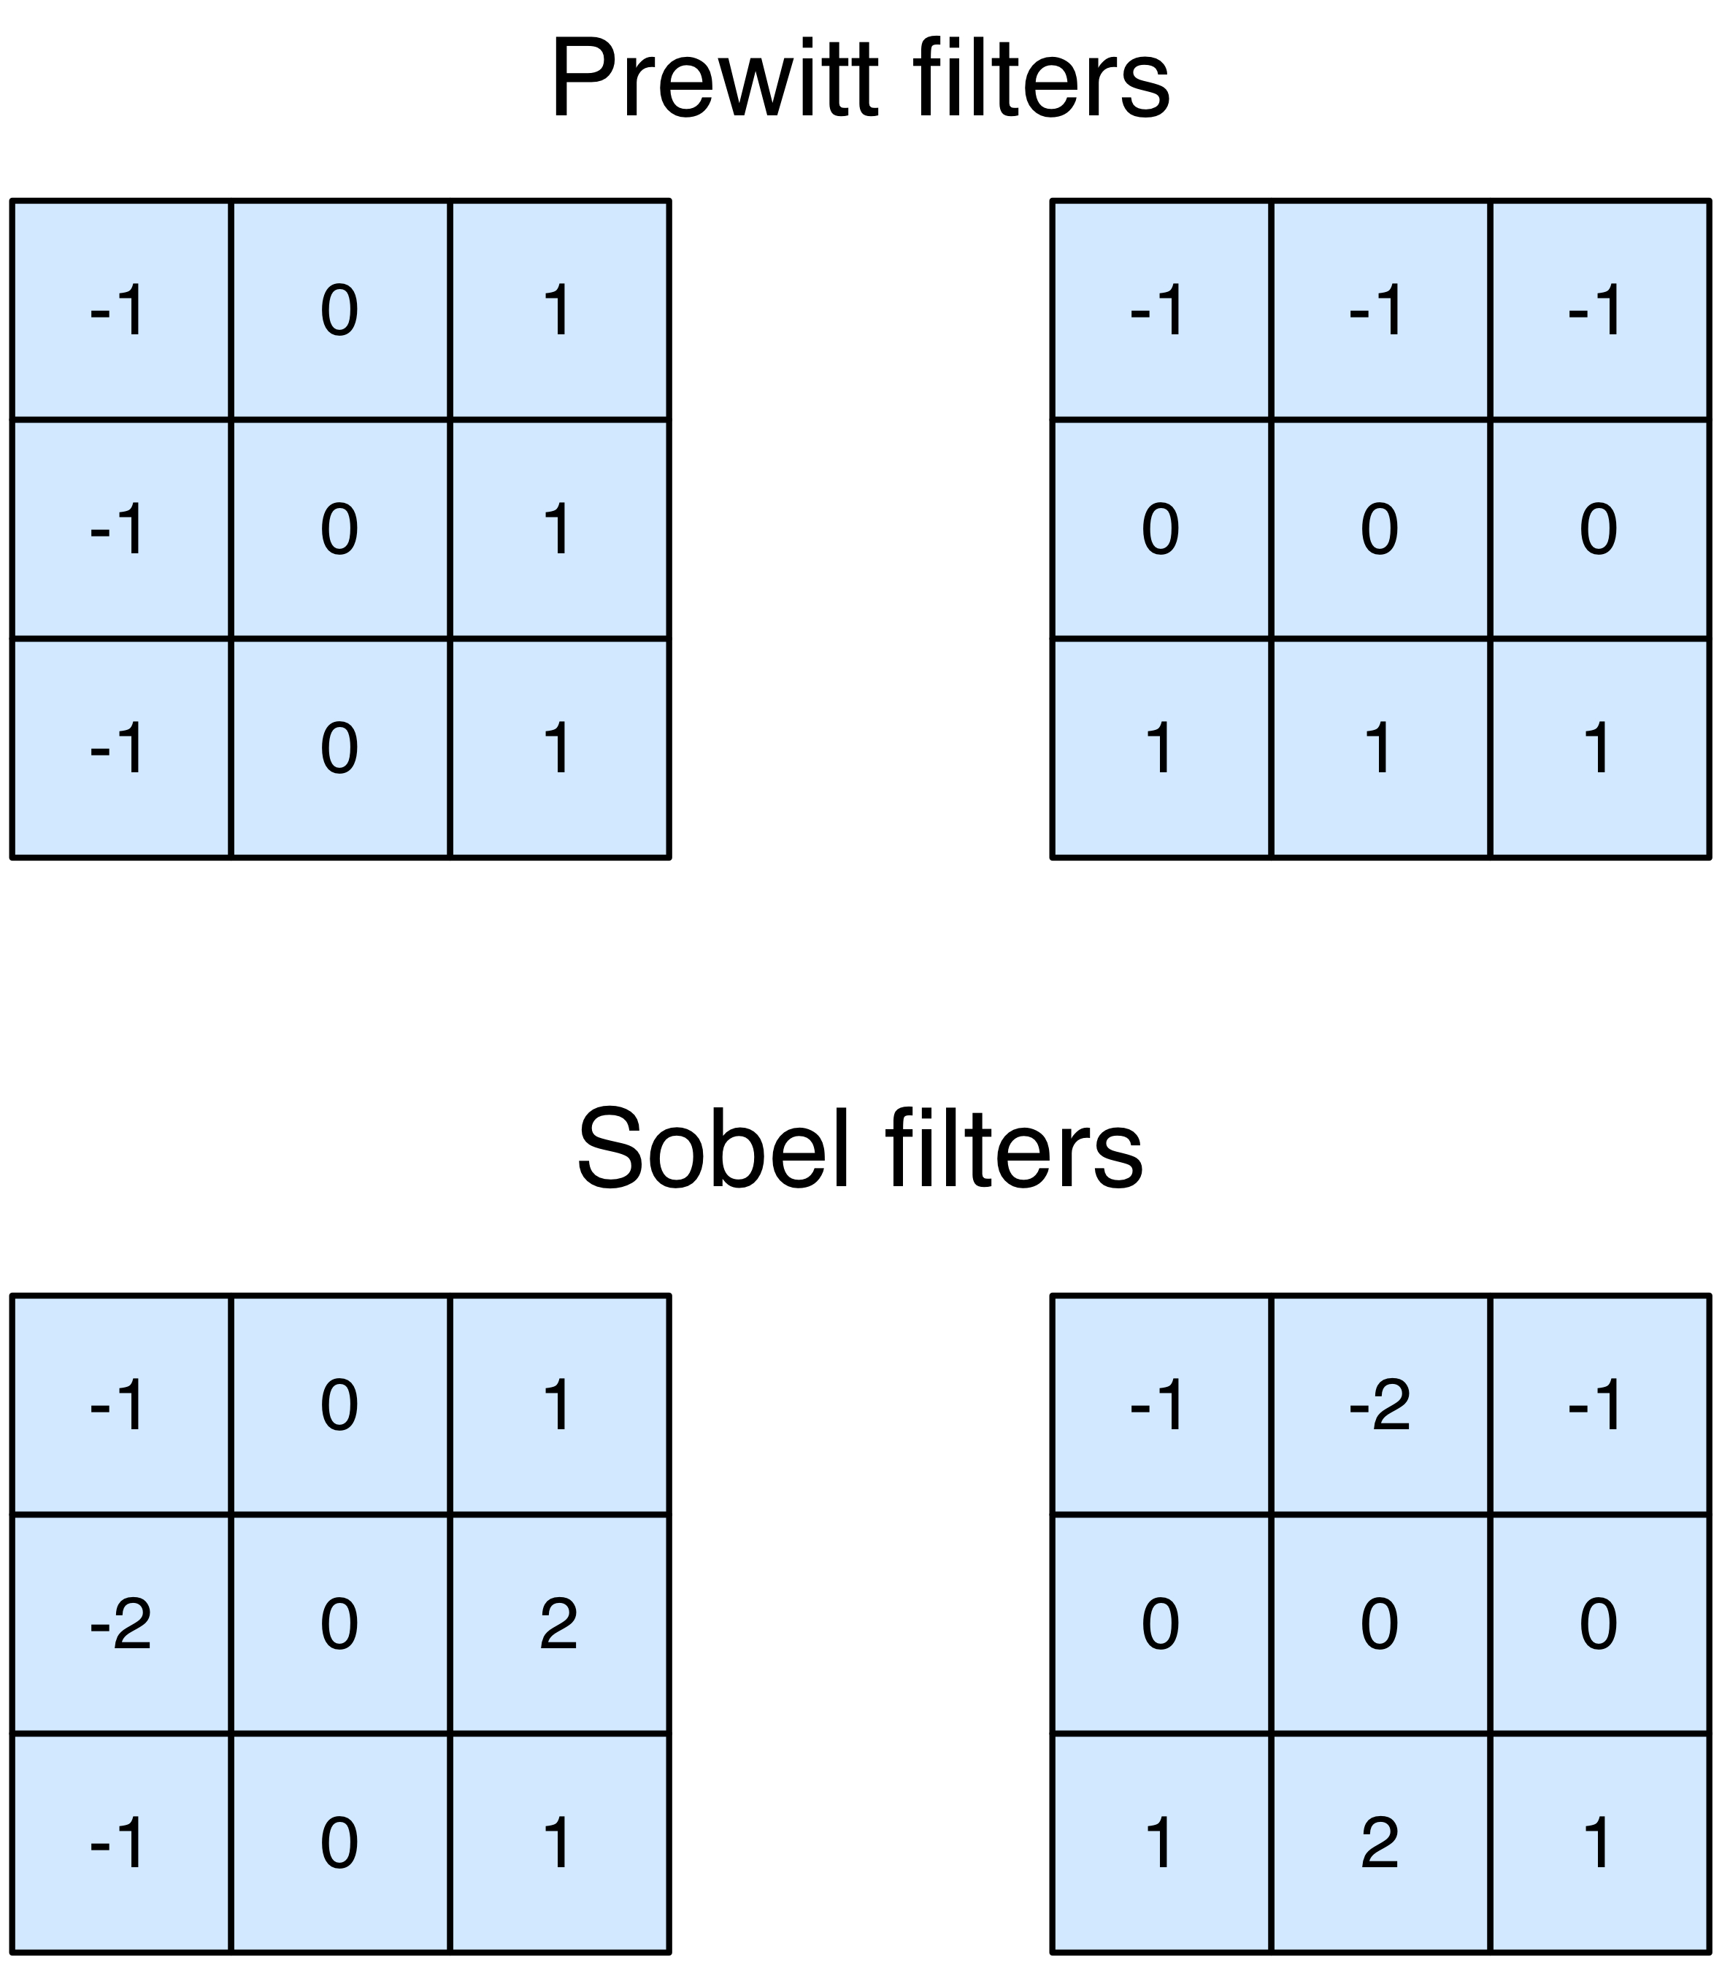
Less Simple Filters
In practice, these simple filters are not used.
Slightly more sophisticated ones have been developed
Filters provide some smoothing in direction perpendicular to the edge
Why? See Matlab
Fall 2009
EN 74-ECE Image Processing
Lecture 7-<number>

Slide 8
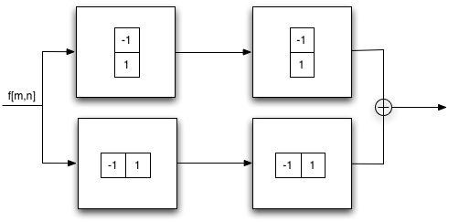
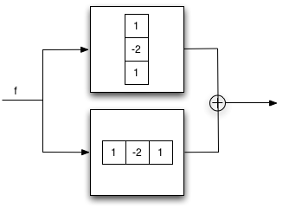
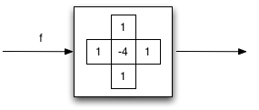
Laplacian filters
Second derivative is first derivative done twice
Fall 2009
EN 74-ECE Image Processing
Lecture 7-<number>

Slide 9
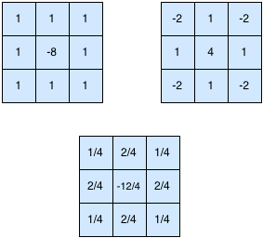
Laplacian again
Same problems as before: smoothing tends to help a bit. So, other 3x3 filters also used to approximate the Laplacian
Fall 2009
EN 74-ECE Image Processing
Lecture 7-<number>

Slide 10
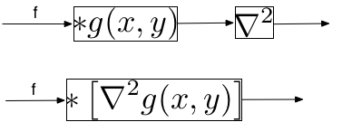
Final Laplacian
One last common idea is to first smooth the image with Gaussian and then find Laplacian
Smoothing and then finding the Laplacian is the same as smoothing with the Laplacian of a Gaussian (LoG)
This type of mixing of operations cannot be done in general. Systems have to be linear and shift invariant (more on this junior year)
Fall 2009
EN 74-ECE Image Processing
Lecture 7-<number>

Slide 11
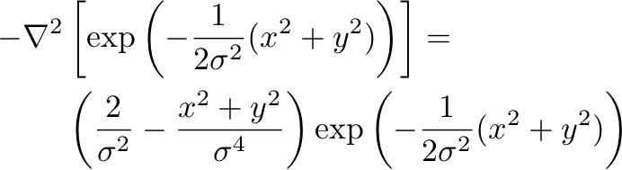
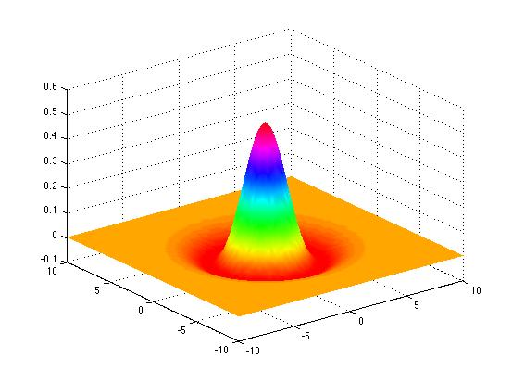
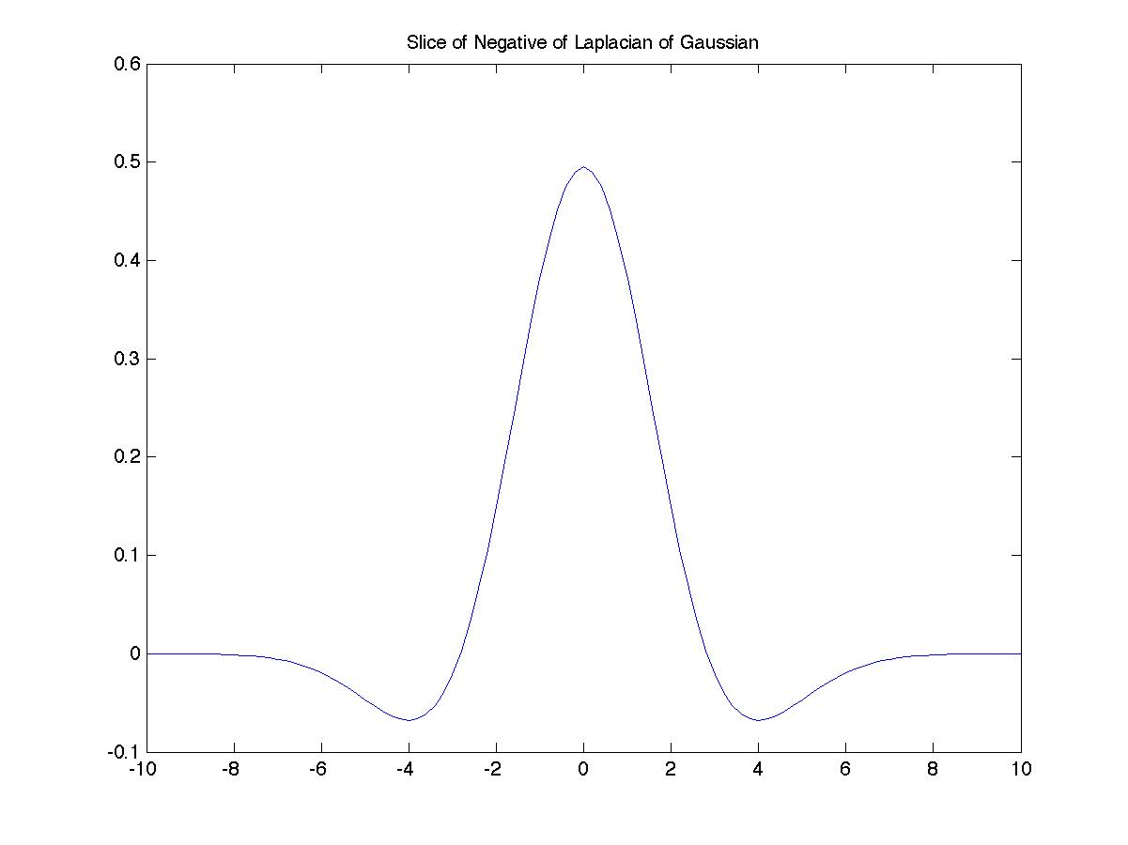
LoG Filter
Note: 4 to 1 peak contrast like discrete case
Fall 2009
EN 74-ECE Image Processing
Lecture 7-<number>

Slide 12
Matlab Topics
Use of meshgrid for generating sets of 2D points
Use of fspecial for building filters
Use of mesh for displaying surfaces and imagesc as an alternate for imshow for displaying pictures
Fall 2009
EN 74-ECE Image Processing
Lecture 7-<number>

